Slide 1
Presentation link: https://youtu.be/8EKbqUgX7Dg Presentated by Dong Li, Xiaoming Su and Lei Fang Team name: iHealth TA : Taylor Startin - tstartin3 Team member: Lei Fang, lfang40, lfang40@gatech.edu Dong Li, dli355, dli355@gatech.edu Xue Liang, xliang70, xliang70@gatech.edu Lu Wang, lwang496, lwang496@gatech.edu Xiaoming Su, xsu39, xsu39@gatech.edu Bo Lin, blin76, blin76@gatech.edu

Slide 2
Birth Certificates on FHIR
Xiaoming Su, Lu Wang, Lei Fang, Dong Li, Xue Liang, Bo Lin
Team iHealth
12/01/2017

Slide 3
Research: current problem
Current birth registration problems
Birth certificate/registration is one of the most important documents. The collection and submission of birth certificate information to state vital statistics agencies is currently the responsibility of birth certificate clerks, typically staff in medical records departments of hospitals. For each birth occurring in a hospital, birth clerks are required to abstract clinical information from the records of both the mother and the newborn. This information is hand-written onto a facility worksheet. A second worksheet, the mother’s worksheet, is completed by the mother and father, if applicable, and contains demographic information about the parents and the desired name of the newborn child. Both worksheets are entered into a web-based form called an electronic birth registration system (EBRS) and submitted to the state health department birth certificate registry.
This process of manually abstracting information from mother and child records is labor-intensive, time-consuming and error prone, and dates back to the time of paper medical records. Thus, an application to facilitate the birth registration process is high preferred.

Slide 4
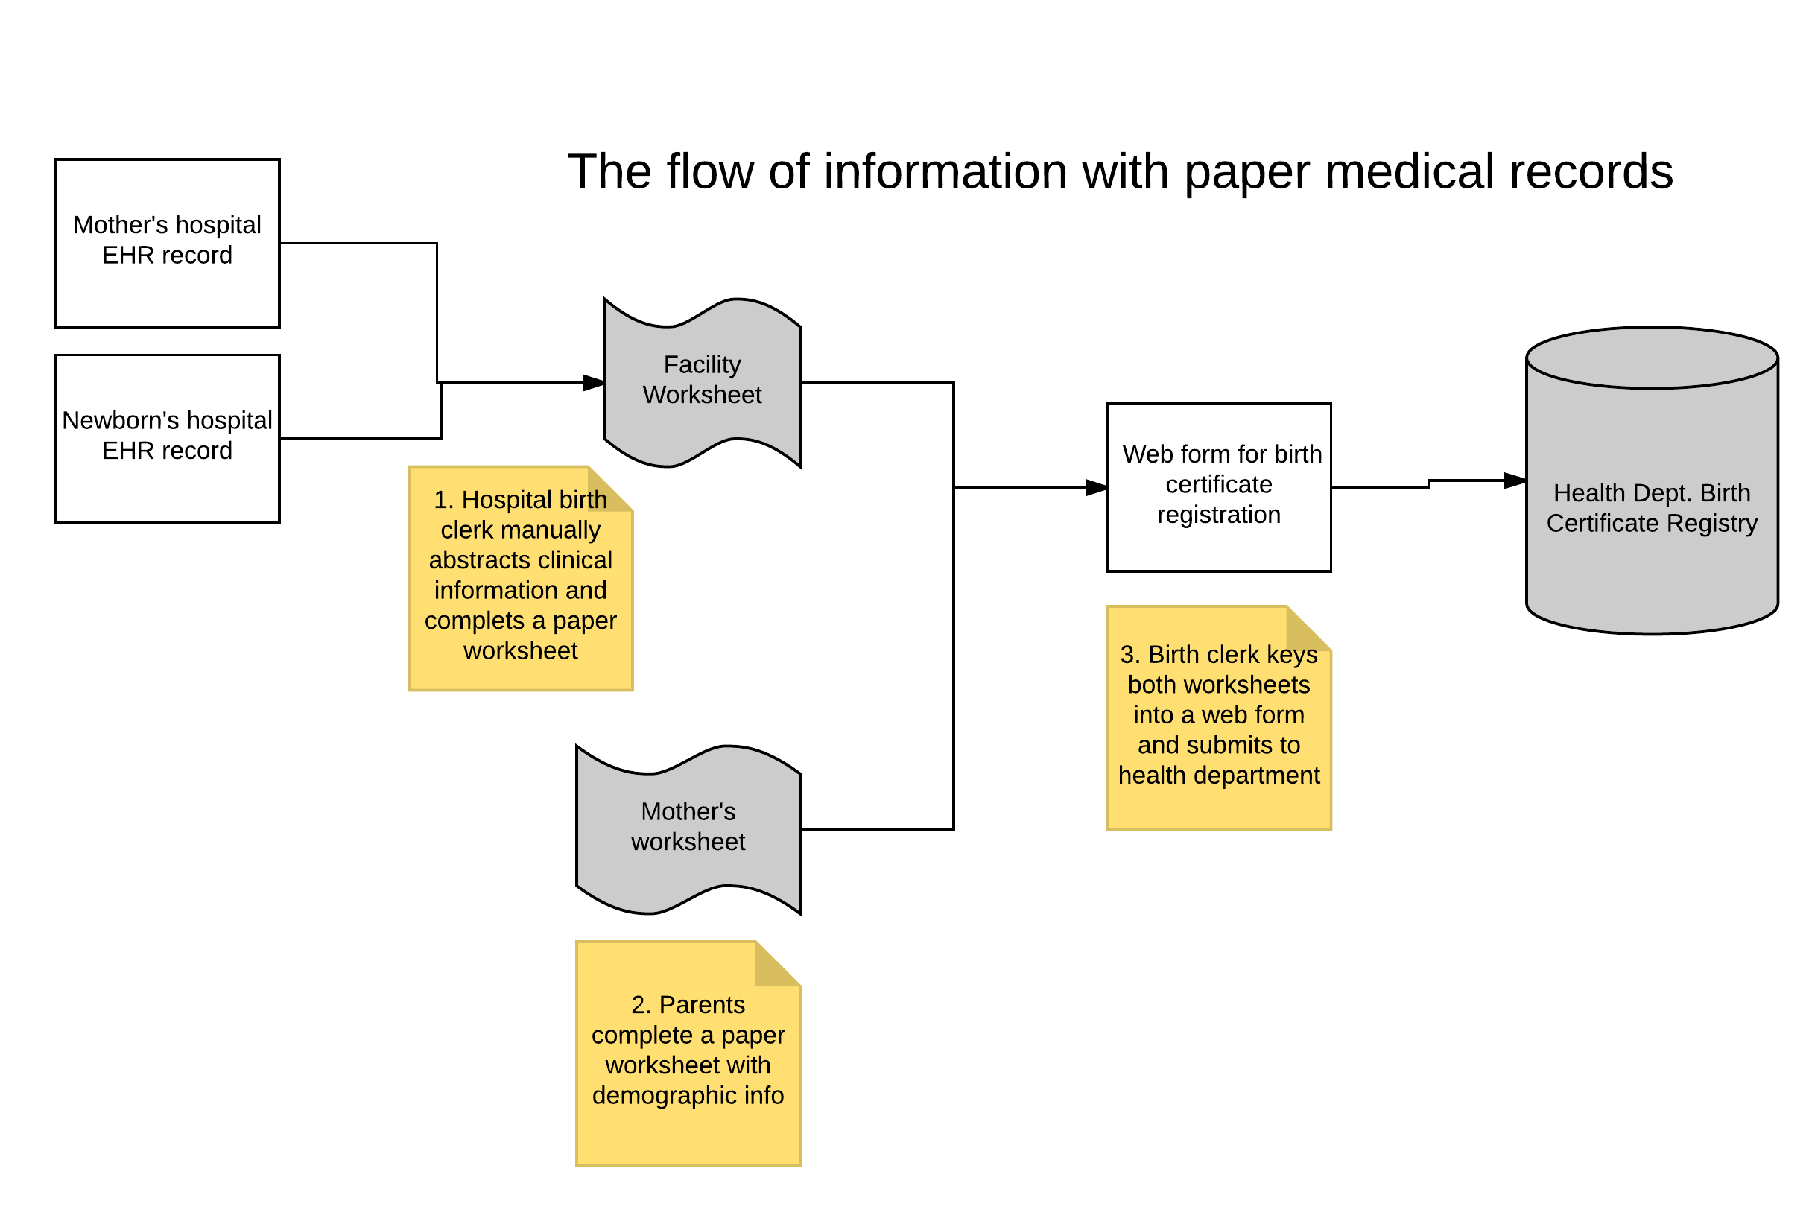
Architectural Diagram
Image was provided by Dr. Ducan

Slide 5
Research: end user requirements and solutions
The end users requirements and our solution
Our team (iHealth) identified problems thoroughly by interviewing prospective end users to understand their requirements. With the help of Dr. Duncan, our team found a way to overcome this challenge by developing a web-based application: an electronic birth registration system which can abstract clinical information from the records of both the mother and the newborn and submit to the state health department birth certificate registry efficiently and accurately.

Slide 6
Overall Project Goals And Objectives
The scope of this project would be to develop the FHIR resource mappings and birth certificate logic to support a SMART-on-FHIR application for birth certificate clerks
Clerk in the EHR would launch the birth certificate app
App would then fetch the necessary data elements
Programming Languages
Web: HTML, CSS, JavaScript, PHP
Database: MySQL
Docker (3 containers):
Mysql
Apache-php
FHIR server

Slide 7
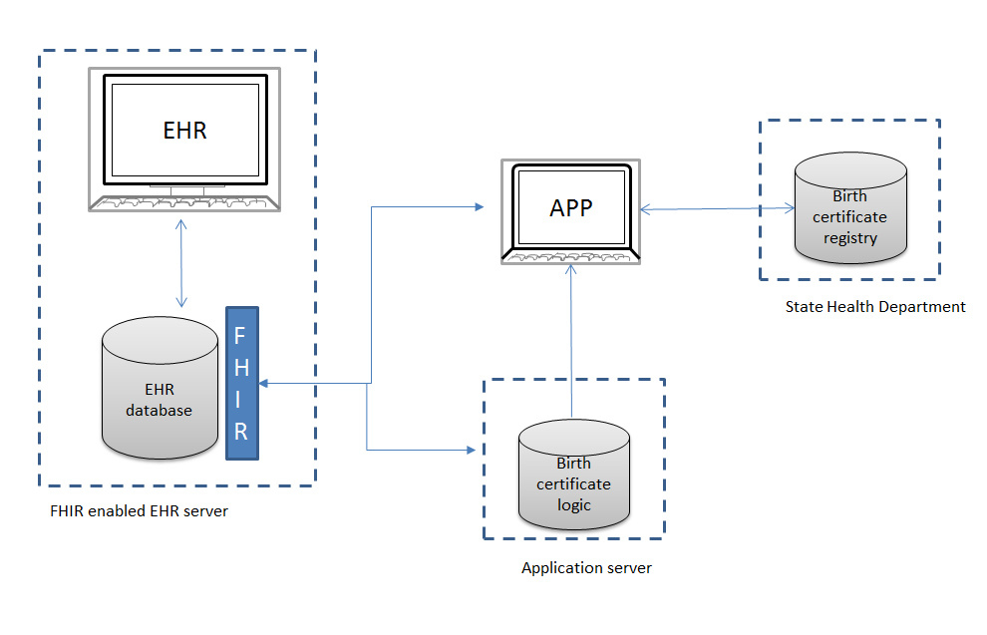
Project Overview
Steps:
Choose a subset of birth certificate information after reviewing the standard birth certificate.
Map birth certificate data elements for each discrete subset identified in (1) to FHIR resource definitions.
Develop logic for the application to translate EHR values to birth certificate values.
Develop a SMART-on-FHIR module with logic specific to the subset that will either pre-populate the birth form or otherwise provide the birth clerk with decision support.
Image was provided by Dr. Ducan

Slide 8
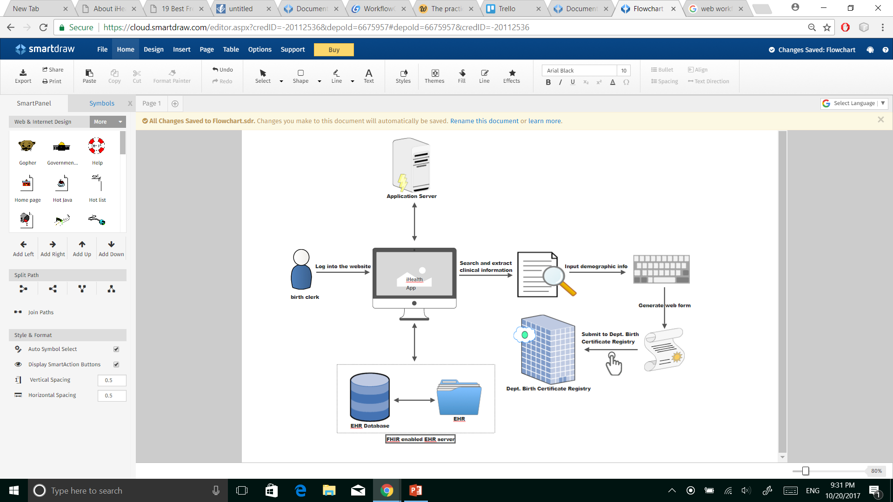
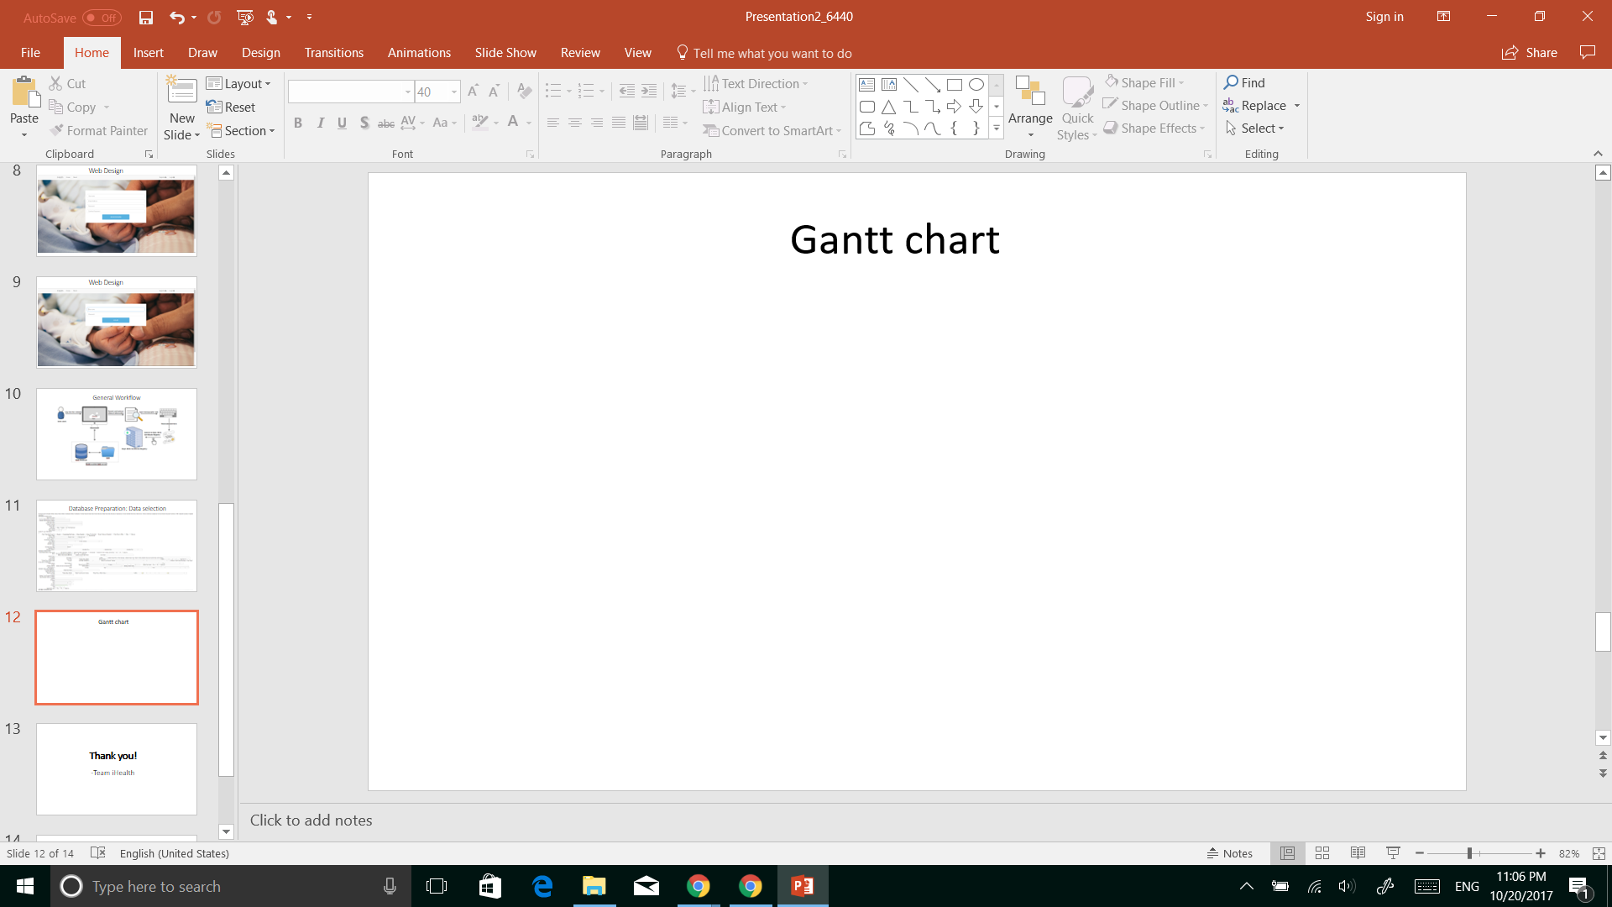
Final Application General Workflow

Slide 9
Full Application Demonstration
A 3 minutes and 47 seconds full functions demonstration about our Web-based Birth Certificates on FHIR apps can be reviewed at the following website
https://drive.google.com/file/d/1IFiLomloQ5yXUGN6_qIEjBbw753DcRT9/view?usp=sharing

Slide 10
Basic Project Requirements Summary: Functionality
Functionality – How well did the final app work and did it fulfill the design proposed by the team? Does it fully meet user requirements?
Based on CS6440 (Introduction to Health Informatics) external/TA mentor projects request, the final apps have the following functions
1) Map birth certificate data elements to FHIR specification for subsets of birth data, e.g. newborn info, newborn medical records;
2) Create a FHIR interface to report part of birth certificate (the full birth registration form is too large for this project, partial dataset is selected for this project).
Our team’s final app works well, and it meets user requirements and it fulfills the design proposed by the team.

Slide 11
Basic Project Requirements Summary: Usability
Usability – Could a user easily understand the app? Was good documentation/help/tutorial provided?
In order to let the end users easily understand and use the app. We have adopted the following strategy:
We follow the principle of efficient and user-friendly design the interface to report all of birth certificate;
We offered a very detailed /help/tutorial documentation.

Slide 12
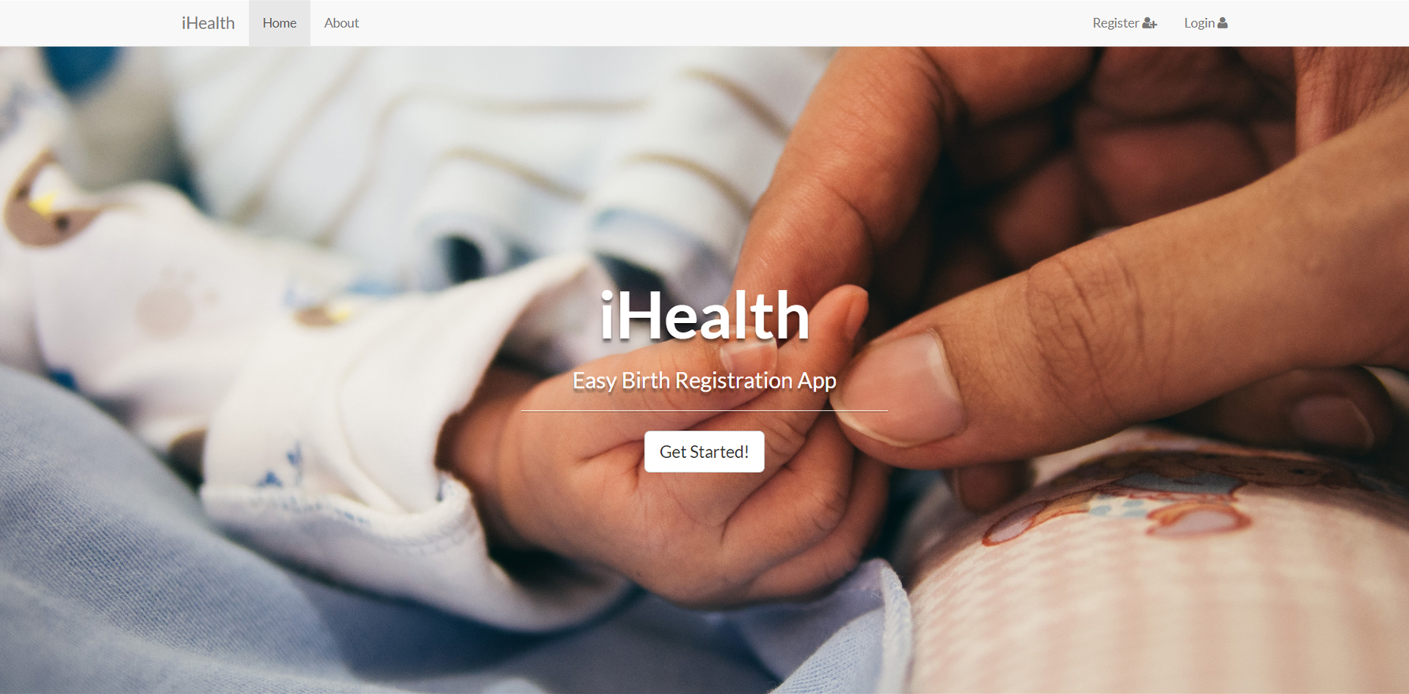
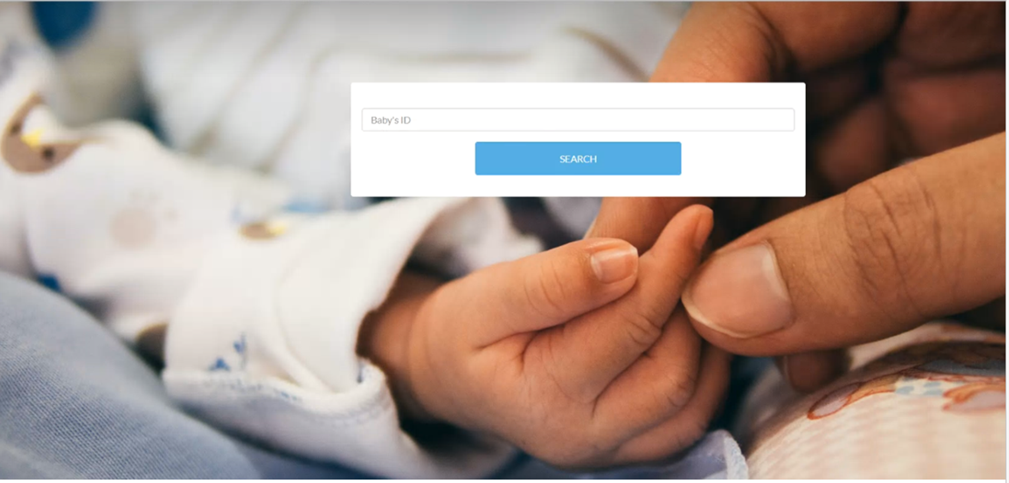
Basic Project Requirements Summary: Design
Attractive, user-friendly and easy-to-use user interfaces
The interface of our app is attractive as well as user-friendly. You can find a brief introduction of the app by click on “About” in the navigation bar. Birth clerks can fill the form related to facility worksheet very easily. They just need to type the Baby ID and click on “SEARCH”. Then the form will be populated automatically!

Slide 13
Basic Project Requirements Summary: Innovation
Innovation – Did the team develop and implement new ideas that aren’t already in common use? Did they bring ideas from other domains into the one they explored?
This web application develops the FHIR resource mappings and birth certificate logic to support a SMART-on-FHIR application for birth certificate clerks. Our website has a very clear and concise interface, which avoids all useless information and make our app more efficient than others. Our application also meets the trend of EHR and fully exploits the advantage of electronic records to facilitate birth registration process. Extracting information from electronic records automatically will also make the birth registration process more accurate and less error-prone.

Slide 14
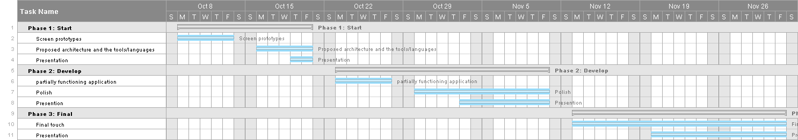
Final Gantt Chart

Slide 15
Team member contributions
We are very lucky, Xiaoming Su, as one of our team’s most important members, taken a considerable amount of work including project design, code writing and debug. Other team members (Lu Wang, Lei Fang, Dong Li, Xue Liang, Bo Lin) are also actively involved in the above work, additionally, Lei Fang is also responsible for the project management as a project manager (PM).

Slide 16
Thank you! -Team iHealth

